Slide 1
Department of Primary Industry and Regional Development
Target Market Opportunities
A Summary

Slide 2
Employment data
Notes:
This data is from 2012-13 and compared to the Research Highlights documents, it would appear that the number of people employed in PI has declined.

Slide 3
Target Market Opportunities (The Project)
Notes:
Businesses producing the 20 products identified were able to apply for grants

Slide 4
How to choose the best opportunities
Notes:
The project focused on identifying ‘growing products and categories’ in Asia/Middle East as these would support WA exports and include such products as chocolate, beef and soya beans.

Slide 5
Target markets

Slide 6
Role of government and industry

Slide 7
Agrifood imports to Asian markets
Notes:
It would be interesting to see if this trend has continued.

Slide 8
Asia wants four broad classes of products
Notes:
The 20 high growth, high potential opportunities that emerged from the process were wine, beer, chocolate, honey, processed ham, sausages, fluid milk, yoghurt, orange/mandarins, carrots, apples, avocados, prawns, rock lobster, beef, sheep, pork, virgin olive oil, animal pellets and rolled oats.
This is the ‘what Asia wants’

Slide 9
What is a premium product?
Notes:
The report focuses on mainstream premium products, not extreme super premium products

Slide 10
WA’s competitive advantage
Notes:
Safety: WA has a modern, professional, trusted well-regulated food industry that produces safe food.
Clean and green: WA is a modern country in a temperate region, with functioning environmental regulations and picturesque scenery.
Quality: WA firms are able to produce high quality foods and beverages
Location: Same time zone as Beijing, Manila, HK and KL. WA is the most easily accessible agricultural zone closest to Asia
People/skills: WA has the people, education system and experience needed to produce good food and beverages.
Story: customers need to now what we produce and how.

Slide 11
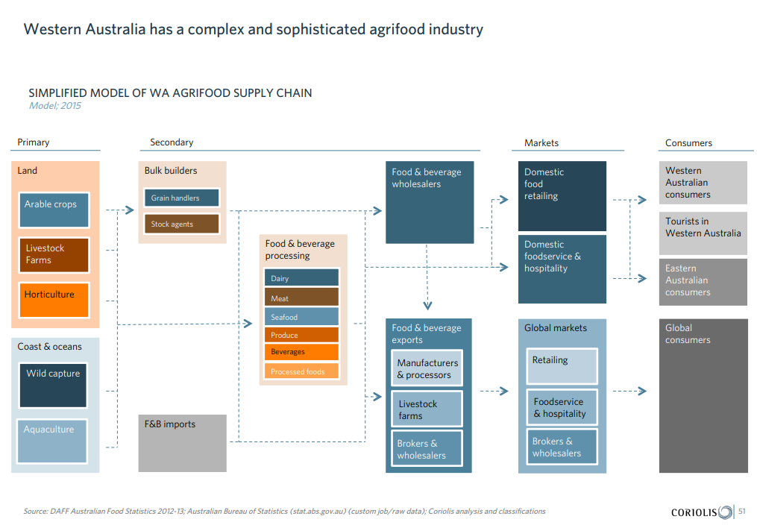
Notes:
A version of the supply chain.

Slide 12
The size of WA’s export value
Notes:
Indicates the potential to expand exports
The report also suggests that WA industry needs to scale up to compete

Slide 13
Opportunities
Notes:
The report looks at each platform in detail providing reasons why the sector is attractive, foods showing growth and what WA could achieve.

Slide 14
Acknowledgements
Images
All images courtesy of Department of Primary Industries and Regional Development (March 2016) CC-BY-3.0-AU ‘Target Market Opportunities in Asia for Western Australian Premium Products’ available at: <https://www.agric.wa.gov.au/sites/gateway/files/coriolis_dafwa_TMO.pdf> [PDF 9.1 MB] accessed 10 August 2021

